Slide 1
Identifying and Addressing SIGNIFICANT factors that lead to Employee Attrition
Presented by:
Delisha Zahra
Kaveri Madhukumar
Mark Anthony Urbino
Sreekanth Gutlapalli
July 14, 2022

Slide 2
1.5 - 2.0
$1,500
hourly
100% - 150%
technical position
213%
high-level position
Notes:
1.5 to 2.0. These are not your grades. According to Heinz (2022), these numbers times a salary is the cost of attrition a company incur per employee. On the average, $1,500 is the cost of attrition per hourly employee (Heinz, 2022). The cost of attrition for a technical position is a 100 to 150 percent of their salary, and around 213 percent salary for a high level position (Heinz, 2022).

Slide 3
1,470 employees
237 resigned
$355,500
237 x $1,500
Notes:
Now, imagine your company has a total of 1,470 employees. Of these numbers, 237 employees resigned. It means that the cost of attrition for the company is $355,500, assuming these 237 are hourly rate employees. This cost only considers the cost of hiring and training new employees (Heinz, 2022). How much more the company will incur if we consider the cost of delayed deliveries, missed production, and other commitment? Because of this, our team deemed the necessity to identify and address the cause of attrition.

Slide 4
Data SET
Our initial dataset contained :
35 variables
1,470 records
Attrition as binary outcome variable
Verified completeness and source reliability
Source: Kaggle IBM HR Attrition
Notes:
Attrition - This could affect companies financially, affect existing employee performance, and decrease profits.
These factors can be addressed by building a data models that could address these issues.

Slide 5
Data Preparation
Cleaning the Dataset
Excel
Eliminating Variables with High Correlation
Correlation Matrix using R.
Significance – More than 0.7%
Visualization
Heat Map and Tableau
Final Dataset for Model Building
24 Variables
Company controlled
Employee Controlled
Notes:
Cleaning dataset - With the use of Excel the data was checked for Null values, duplicate entries or incomplete data.
The dataset contains 35 variables, of which all might not be necessary for model building. With the use of a correlation heat map, the number of variables are reduced.
Building the correlation Matrix and creating a heatmap
Variables with significance more than 0.7 % are considered highly correlated and can be replaced.

Slide 6
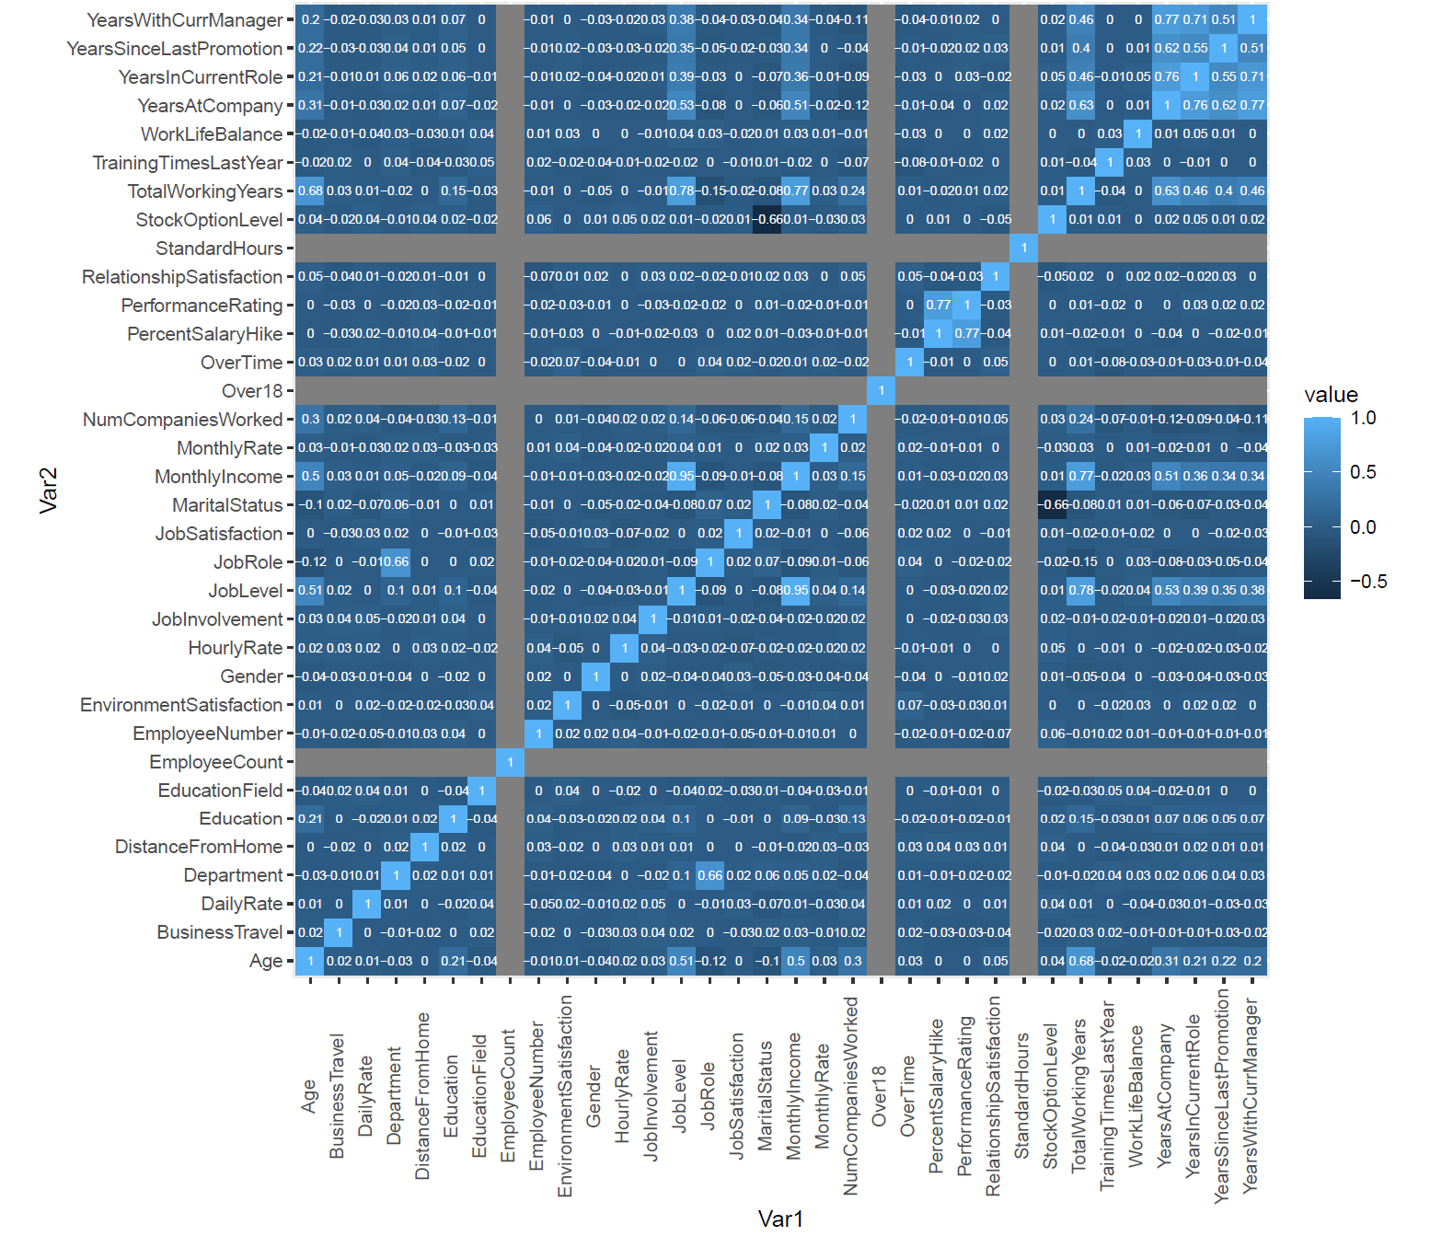
Correlation heat map for all variables
Notes:
High Correlation –If the values are greater than 0.7 or less than -0.7
Based on high correlation parameters, we identified the following variables to be highly correlated:
YearsWithCurrentManager, YearsSinceLastPromotion, YearsinCurrentRole, and YearsAtCompany
TotalWorkingYears, JobLevel, and MonthlyIncome
PercentSalaryHike and PerformanceRating
Based on these relationships, we selected the following variables to represent the factor:
YearsAtCompany
MonthlyIncome
PerformanceRating

Slide 7
Initial models
Random Forest
Logistic Regression
Extension of decision trees
Works by randomly selecting subsets of features.
Works by encoding each category with a numeric value.
Performs well with categorical features.
Provides probability of each observation falling into a specific category.
Could treat some variables with higher importance.
Performs well with categorical features.
Notes:
As we build our model, we check any potential class imbalanced and noted 84:16 ratio. To address the imbalance, we oversampled the minority class.
Due to the fact that Logistic regression calculated based on weights, it could encode certain categorical variables and treat them with higher importance.

Slide 8
Random forest Model
Accuracy for Trained model
The model generated 99.94% accuracy on a trained model
Validation Set
The model generated 86.62% accuracy.
Sensitivity and Specificity
Validation set derived 98.11% Sensitivity and 25.71% Specificity
Notes:
Specificity is a measure of True Positives vs. False Positives: how often it can accurately identify cancer.
High specificity indicates that, if the test reads positive, the person very likely has cancer.
Sensitivity is a measure of True Negatives vs. False Negatives: how often it misses cancer.
High sensitivity indicates that, if the test reads negative, the person very likely doesn't have cancer.
A test with a high sensitivity is very safe; you will almost never miss someone with cancer.
However, if the specificity is low, you're going to get a lot of False Positives and waste a lot of money with additional tests and treatments.
A test with high specificity is nice because, if someone reads positive, you are confident that they do in fact need treatment, saving cost.
However, if sensitivity is low, many people who do in fact need treatment may not get it.

Slide 9
Logistic Regression Model
Accuracy for Trained model
The model generated 73.03% accuracy on a trained model
Validation Set
The model generated 79.59% accuracy.
Sensitivity and Specificity
Validation set derived 84.37% sensitivity and 54.29% Specificity
Notes:
The test set confusion matrix for logistic regression shows a higher accuracy compared to training set. This accuracy situation with logistic regression appears to be unusual (i.e., test set accuracy being greater than train set). One of the reasons of this is due to the allocation of samples or the type of data used. Since we used oversampling to address the class imbalance of our dataset there is a likelihood that logistic regression’s accuracy will be affected.
In the article posted by Zummel (2015), she discussed that balancing classes has a higher possibility of improving random forest model while negatively effecting logistic regression. Hence, for comparison purposes, we also generated the confusion matrices of logistic regression using the unbalanced dataset and compared the result to a balanced random forest model confusion matrix.

Slide 10
Model we considered
Random Forest is picked as the final model.
Higher predictive accuracy.
Comparison between balanced and unbalanced class still yielded higher accuracy.
Notes:
Confusion matrixes were created for both the models. Despite using a balanced and unbalanced class, there was higher predictive accuracy with Random Forest for all training and testing sets.
Sensitivity
The only exclusion to the metrics was the low specificity in the Random Forest model that we addressed as part of the cross validation of the Random Forest model.

Slide 11
Random Forest CROSS Validation
MEthod
K-Fold Cross Validation method.
Implementation
Class Imbalance was addressed.
Hyper Parameters were picked by the algorithm.
K-fold model was run with hyper parameters for best accuracy and performance of model.
RESults
Training set accuracy is 87.30 while the test set is 82.77.
No overfitting concerns.
Notes:
The method was ran using random parameters, and then the algorithm was used to pick out the best hyper parameters. This ensures more accuracy and performance of the model. The training set always yields a higher accuracy than a validation set, however as analysts it is important to notice that the difference in accuracy is not too much between the training and validation set. Extra difference could mean there could be a potential overfitting issue. With only 4.53% difference between the training and testing accuracy, we can deem that the model is working well without overfitting concerns.

Slide 12
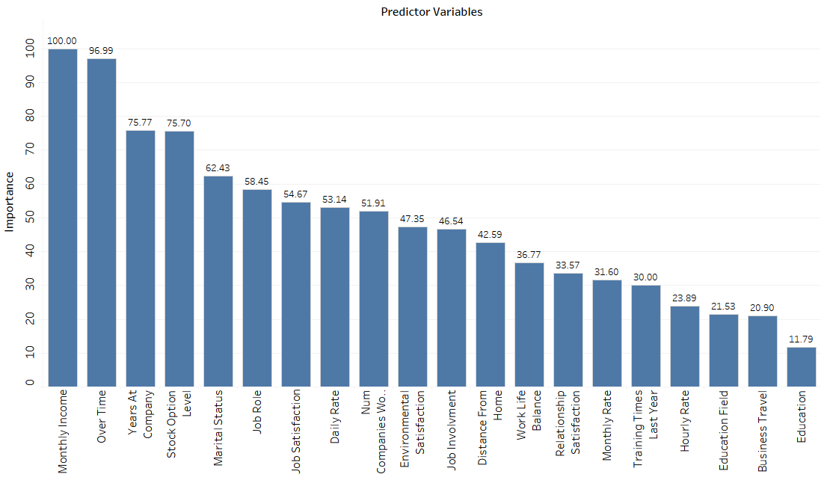
Variable Importance Plot
Top 5 variables
Company Controlled
Monthly Income
Overtime
Stock level option
Employee Controlled
Years at company
Marital Status
Notes:
After running the model, the above is the variable importance plot that determines which variables have the most impact on Attrition. Monthly Income, Overtime, Years at company, Stock Option Level and Marital status are the top 5 variables that need to be addressed. Out of the top 5 , three variables are Company controlled which means the company can implement changes to reduce the issue.

Slide 13
Model Implementation
6 months
1 year
5 years
To implement the model
To determine ways to address factors to attrition
Initial review after model deployment
Financial Impact
Operations Performance
Further enhancements to the model
Ongoing review of the model
Comparing of annual performance before and after model deployment

Slide 14
RECOMMENDATIONS- Monthly Income
Cost of replacing valued employee ranges between 100 to 300% annual salary.
To lower attrition the recommendation is to increase wages for new employees.
Adjust salaries according to market rate for existing employees.
Proper communication with employee about reasons for not increasing salary.
Notes:
There is research that suggests valued employee replacement costs companies between 100 to 300% and all this does not include factors like lousy productivity, lost business, impact on customer satisfaction, decrease in morale, and loss of intellectual capital. This factor makes it important to retain existing employees and new hires. According to the study conducted by Payscale (n.d.), an organization that keeps up-to-date with market rate, adjusts their employee’s salary based on the market movement and this leads to lower attrition rates.

Slide 15
Recommendations- Overtime
Increase in overtime causes imbalanced work-life balance leading to mental stress and pressure.
Using a scrum pattern can lead to efficient handling of work tasks across teams.
Research backs scrum as an efficient way to reduce overtime with an almost 3-time decrease.
Notes:
Overtime can lead to a loss in balance between work life. This could cause a domino effect into the employee’s rhythm causing the employee to deliver poor performance. Addressing overtime issues can help the employee deliver their best version. Scrum is mostly seen in software development, and there is a misconception of it being a methodology only for software related organizations. But the good news is that it can be used in any industry to implement a better work schedule across different teams. Mann, C. & Maurer, Frank. In their article mention a three time decrease in overtime after the implementation of scrum policies.

Slide 16
Recommendations- Stock Options and Others
Offering a Stock Options can reduce Attrition by 2%.
01
Higher job satisfaction via job involvement and training led to lower Attrition.
02
Training in current technologies improved confidence in employees.
03
Notes:
Offering stock options is an incentive that has potential to grow with the employee. As the company demand increases there is increase in stock option growth. This is a good way to retain employees. A the journal published by Autoparts Asia (2017), the company has noted that their employees who received regular technical trainings experienced improved confidence. The confidence resulted from the employees to be up-to-date with the current technologies that the company uses (Autoparts Asia, 2017). This confidence benefited the company by having a low turnover rate.

Slide 17
References
Autoparts Asia. (2017). HR Policies & Practices: Managing Attrition. Retrieved from https://link.gale.com/apps/doc/A578956344/ITOF?u=canyonuniv&sid=ebsco&xid=2f0cb4c5
Heinz, K. (2020). The true cost of employee turnover. Retrieved from https://builtin.com/recruiting/cost-of-turnover
Mann, C. & Maurer, Frank. (2005). A case study on the impact of scrum on overtime and customer satisfaction. Proceedings - AGILE Confernce 2005. 2005. 70 - 79. 10.1109/ADC.2005.1.
Payscale. (n.d.). How you pay raise practices affect employee turnover. Retrieved on July 20, 2022 from https://www.payscale.com/research-and-insights/employee-turnover-pay-raises/
Payscale. (2022). Average data analyst salary in Phoenix, Arizona. Retrieved on July 19, 2020 from https://www.payscale.com/research/US/Job=Data_Analyst/Salary/3708f2ef/Phoenix-AZ
Zummel, N. (2015). Does balancing classes improve classifier performance? Retrieved from https://win-vector.com/2015/02/27/does-balancing-classes-improve-classifier-performance/

